Slide 1
House Price Prediction Analysis Case
Capstone Project
Presentation

Slide 2
TABLE OF CONTENTS
01
02
03
PROBLEM & SOLUTION
OUR PROCESS
TARGET

Slide 3
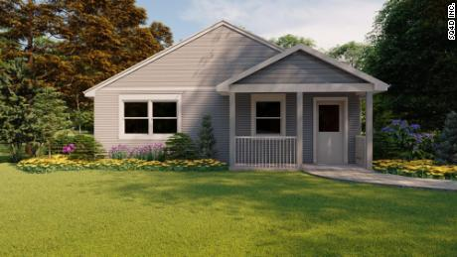
House Price Prediction
The median home price in the United States is $374,900 as of the second quarter of 2021. Home prices increased by 16.2% from 2020 to 2021. The median home price increased by 416% from 1980 to 2020. The Zillow Home Value Index puts the typical home price in the United States at $293,349.

Slide 4
UNDERSTANDING THE PROBLEM
House Price
The increasing house price catches my attention, therefore I create a dataset and find out what variables affect the house price most.
I want to create a regression model which can predict the house price so that I could find out the undervalue house in the community.
.

Slide 5
House Price
House price influencing factors:
Common perspective:
House price should be higher if lot size is larger, house quality is better
House supply and demand, locations, lot size, house quality, environment……

Slide 6
MAIN PROCEDURES OF PROJECT
DATA CLEANING
EXPLORATORY DATA ANALYSIS
Preprocessing Data
MODEL EVALUATION

Slide 7
The Ames house dataset
DATA COLLECTED FOR ANALYSIS
The Ames Housing dataset was compiled by Dean De Cock for use in data science education. It's an incredible alternative for data scientists looking for a modernized and expanded version of the often cited Boston Housing dataset.

Slide 8
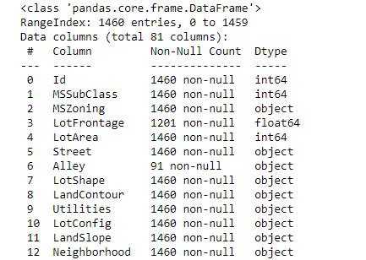
Data Cleaning Process
Churn
The dataset has 1460 entries and 79 variables (exclude ‘Id’ and dependent variable ‘SalePrice’), and there are some null value have to be replaced.
Retention
Churn
90%
10%

Slide 9
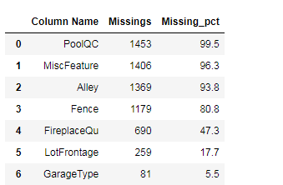
Data Cleaning Process
There are 4 variables missing more than 80% values and 1 variables is missing around 50% values, we will drop them.

Slide 10
Exploratory Data Analysis
Feature selection, which is choosing the most relevant/valuable features of your dataset can improve the accuracy of the model. Too many features can cause your algorithm to overfit, and too little features can cause your algorithm to underfit.
Feature Selection:

Slide 11
Exploratory Data Analysis
Since the dataset has 79 features which can result to model overfitting, we can improve the accuracy the model by selecting the 20 most important features to create a new dataset for further analyzing.
Feature Selection:

Slide 12
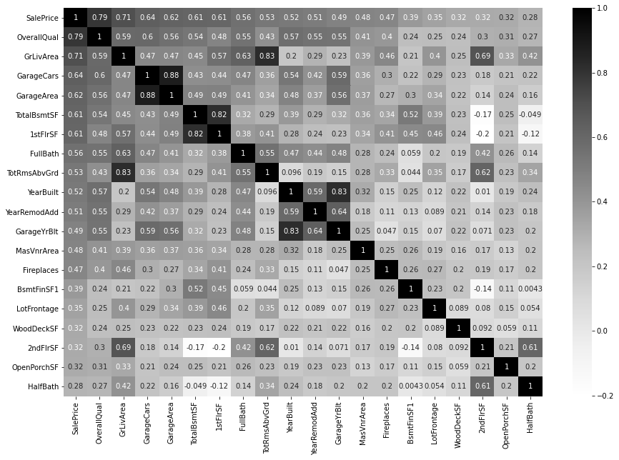
Exploratory Data Analysis
Feature Selection:
Here are the 20 most important features. From the heat map, we can see some variables are highly correlated, which leads to multicollinearity.

Slide 13
Exploratory Data Analysis
Multicollinearity :
Solution :
Multicollinearity is a phenomenon in which one predictor variable in a multiple regression model can be linearly predicted from the others with a substantial degree of accuracy. The variables are highly correlated will affect the performance of the model.
For the two highly correlated variables, remove either one variable and keep the other variable.

Slide 14
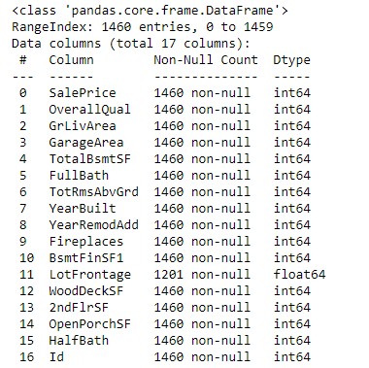
Exploratory Data Analysis
Replacing null value :
After selecting the most important features and drop the multicollinearity features, we can still find some null values in ‘LotFrontage’ column, we will replace the null value with the mean value.

Slide 15
Preprocessing Data
An outlier is a data point that differs significantly from other observations. An outlier may be due to variability in the measurement or it may indicate experimental error; the latter are sometimes excluded from the data set. An outlier can cause serious problems in statistical analyses.
Outliers:

Slide 16
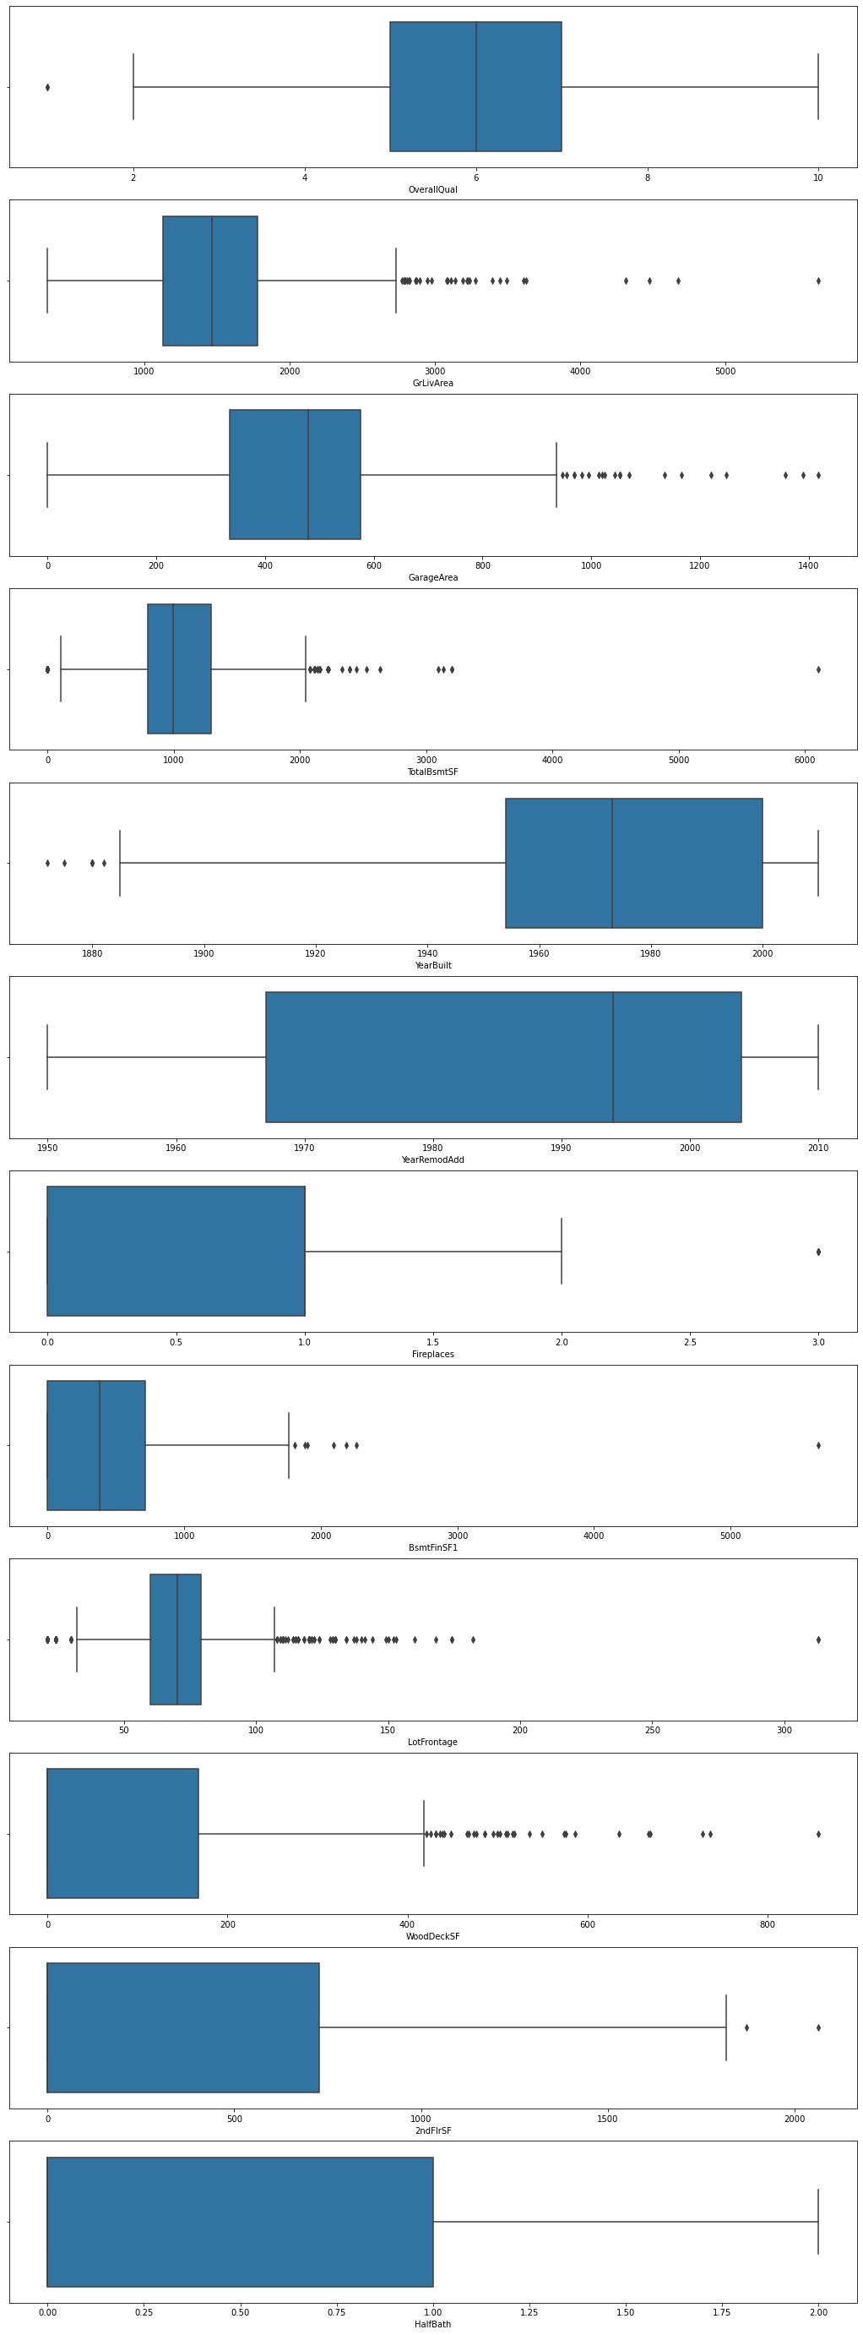
Preprocessing Data
The most common way to identify an outlier are::
Data point that falls outside of 3 standard deviations. From the boxplot, we can see there are some outliers existing in the feature column. We will replace the outliers with the mean value in the feature column.

Slide 17
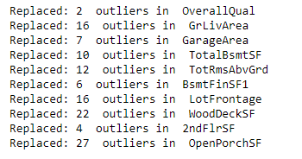
Preprocessing Data
Outliers are replaced by the mean value of feature column.

Slide 18
Preprocessing Data
Normalization is a technique often applied as part of data preparation for machine learning. The goal of normalization is to change the values of numeric columns in the dataset to use a common scale, without distorting differences in the ranges of values or losing information.
Normalization:

Slide 19
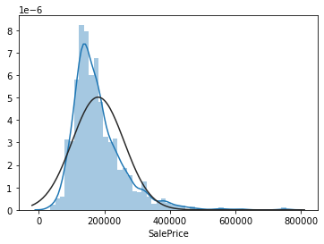
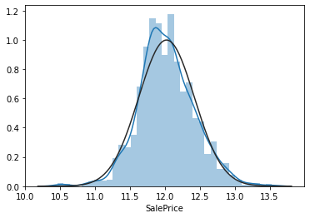
Preprocessing Data
Before normalization:
After normalization:

Slide 20
Model Evaluation
Model Score:
Linear Regression
Decision Tree
Random Forest
KNN - k-nearest neighbors
SVM - Support vector machine

Slide 21
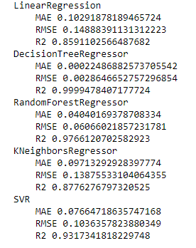
Model Evaluation
5 regression models chosen for evaluating the dataset.

Slide 22
Model Evaluation
I choose RMSE as the accuracy metric, mean absolute error(MAE) and R square because they can give us a better picture which algorithm performs better. The RMSE is useful when large errors are undesirable. The smaller the RMSE, the more accurate the prediction because the RMSE takes the square root of the residual errors of the line of best fit. MAE measures the average magnitude of the errors in a set of predictions, without considering their direction. It’s the average over the test sample of the absolute differences between prediction and actual observation where all individual differences have equal weight. The r-squared value provides an estimate of the strength of the relationship between the independent variables in the model and the dependent variable. The model performs better, the r square is closer to 1.

Slide 23
Model Evaluation
Model Winner:
Decision Tree
&
Random Forest

Slide 24
Model Evaluation – Further Analysis
Decision Tree:
Mean absolute error: 0.16 dollars
Accuracy: 98.68%

Slide 25
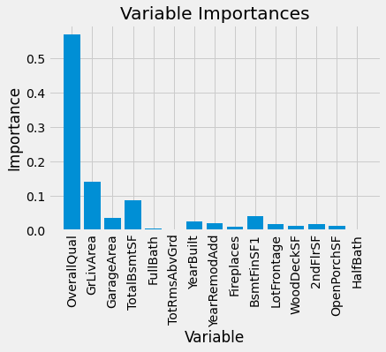
Model Evaluation – Further Analysis
Decision Tree:
Feature Importance:

Slide 26
Model Evaluation – Further Analysis
Random Forest:
Mean absolute error: 0.11 dollars
Accuracy: 99.1%

Slide 27
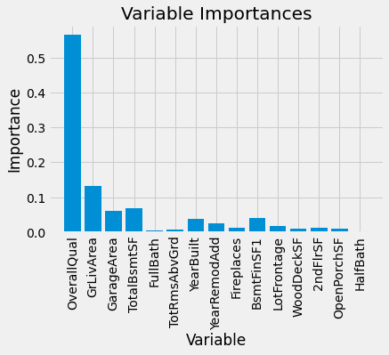
Model Evaluation – Further Analysis
Random Forest:
Feature Importance:

Slide 28
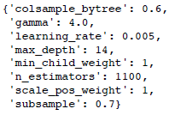
Exam Model – 5 Fold Cross Validation
Best parameters
found:

Slide 29
ANALYSIS – Feature Importance Intuition
In the feature importance graph above we can see that overall quality, living area and garage area are the features that appear the most in our model and we could tell that these 3 features have a significant importance in our model which make sense that bigger and nicer houses are selling on higher sale price.

Slide 30
THANKS

